Slide 1
Lung cancer mortality
Machine Learning Project
Amaia Urquia Samele

Slide 2
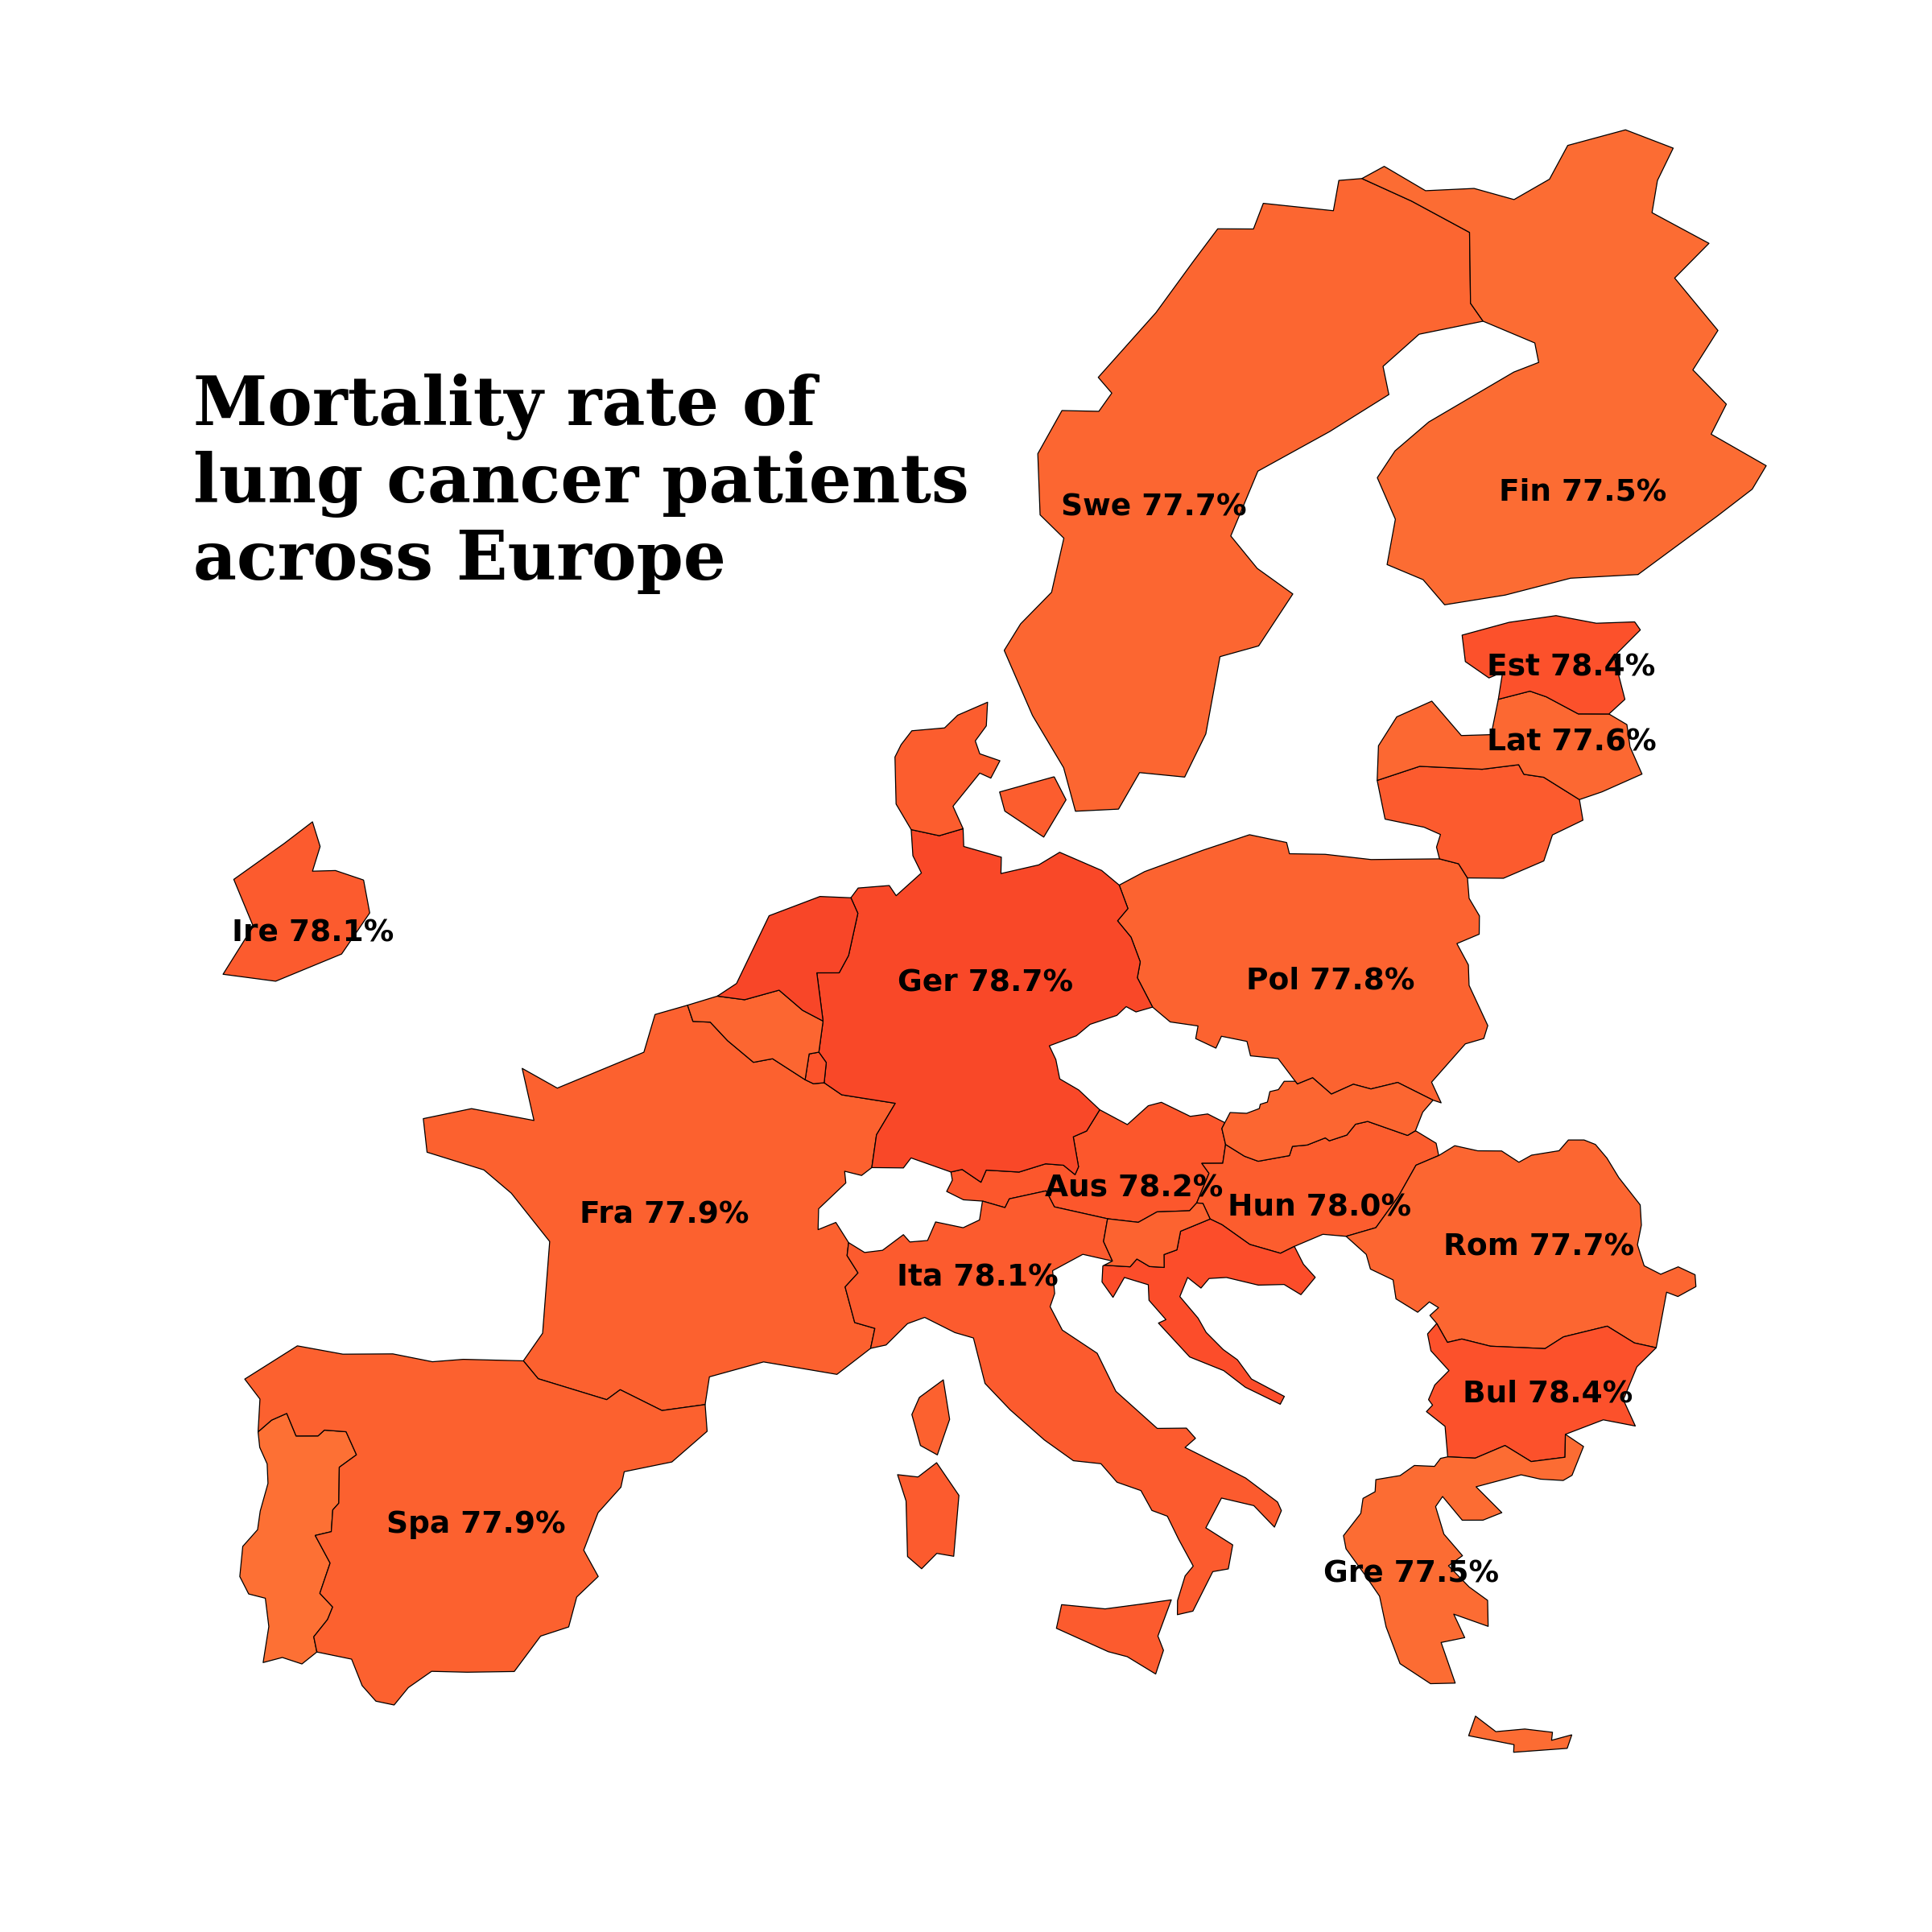
Mortality vs country
Small variation in mortality though no significant different between country
1.2% difference between max and min

Slide 3
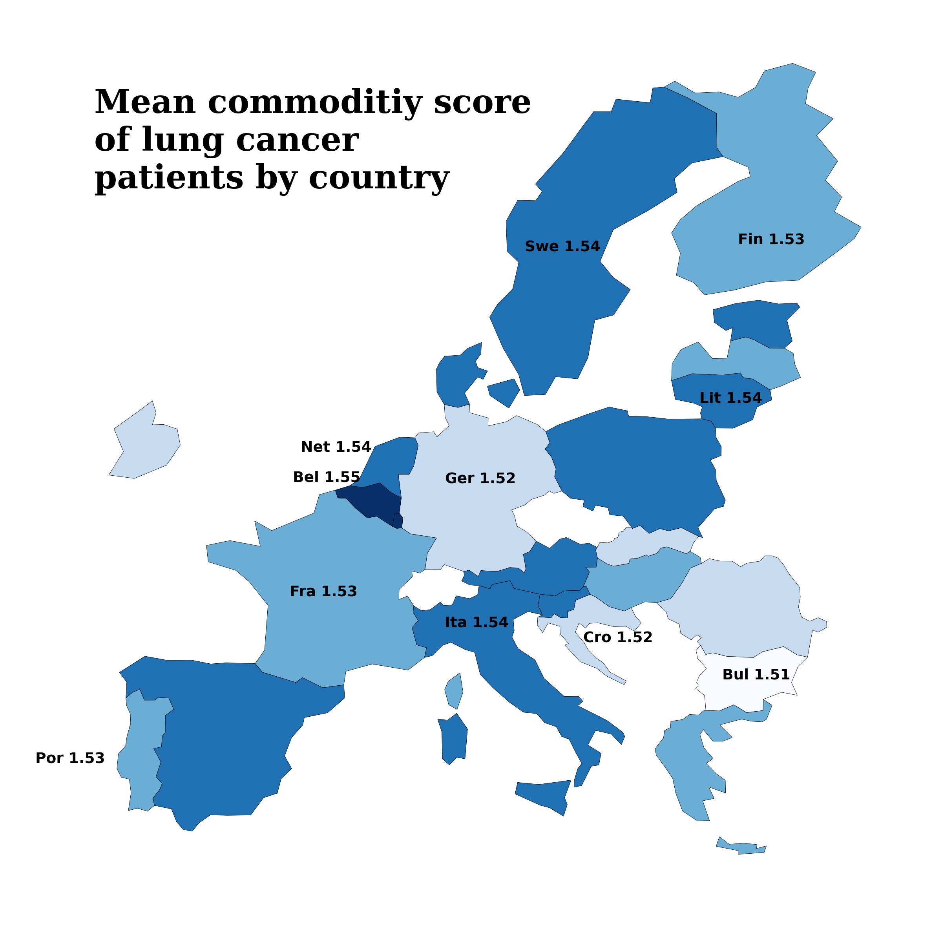
Health parameters vs countries
Creating a scaled health metric combining commodities to map distribution across Europe.
This score included: hypertension, asthma, cirrhosis,
0.04 difference between max and min

Slide 4
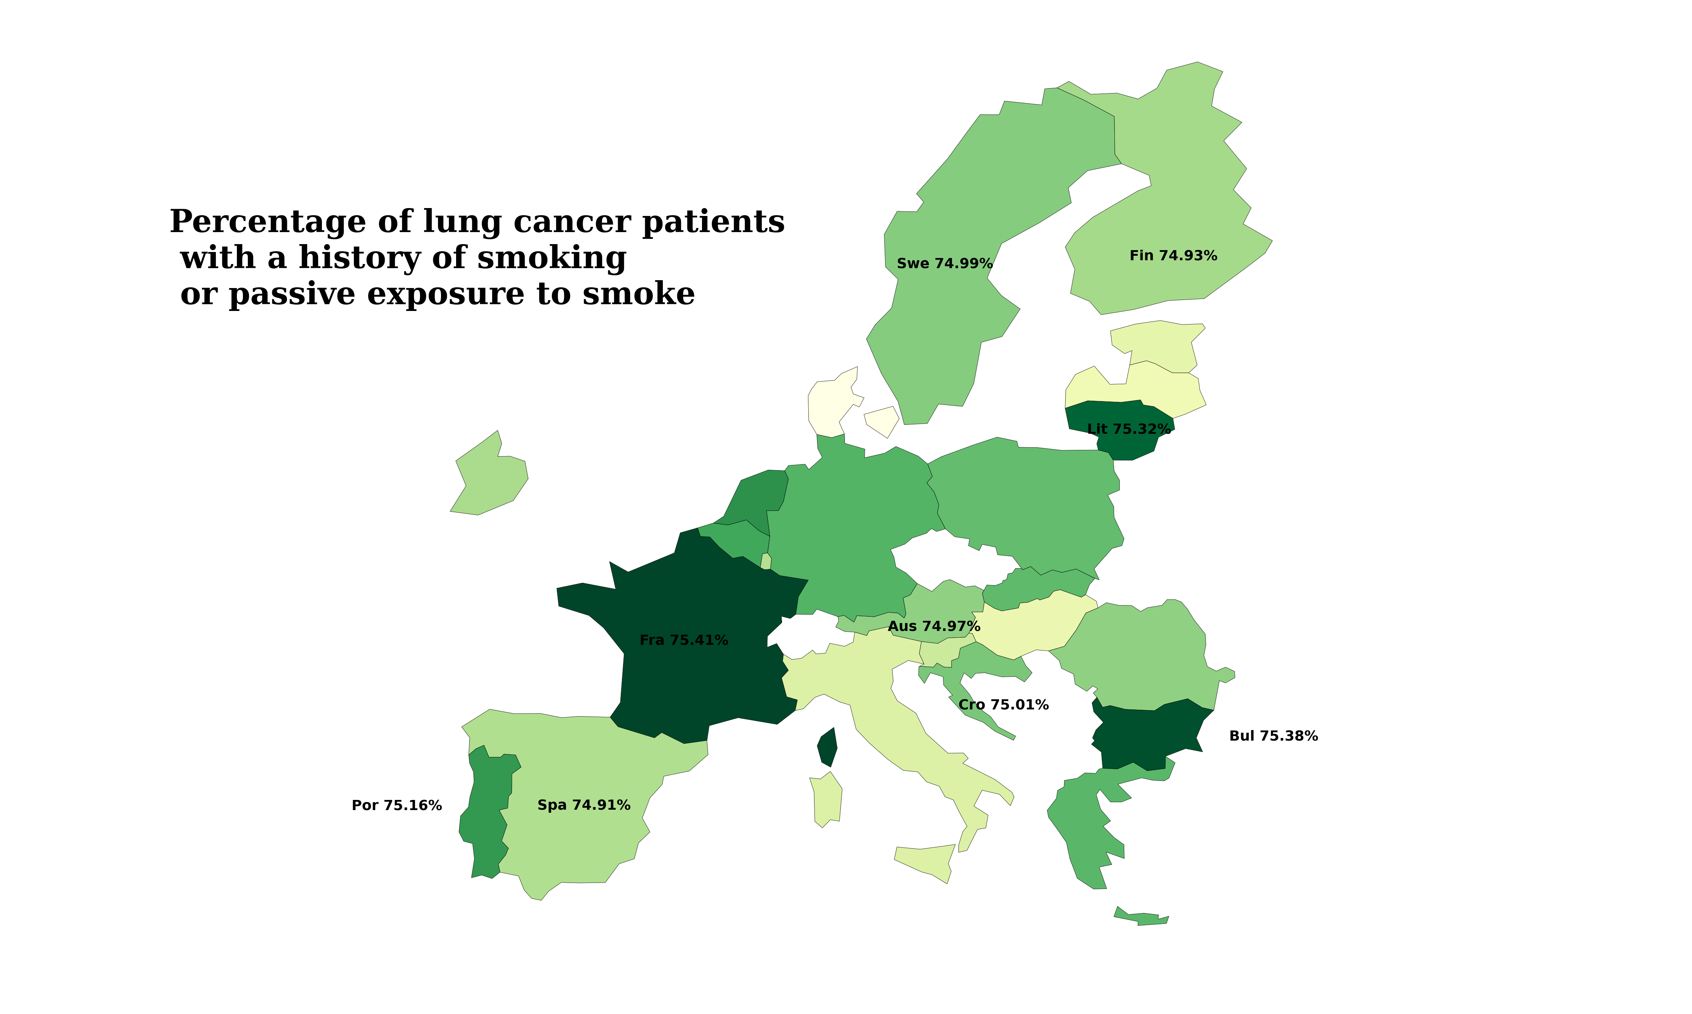
Smoking across Europe
Similar trend, not much variation

Slide 5
We can’t see many patterns, especially considering the range of results is so small
Suggests that health and smoking habits do not greatly differ by region

Slide 6
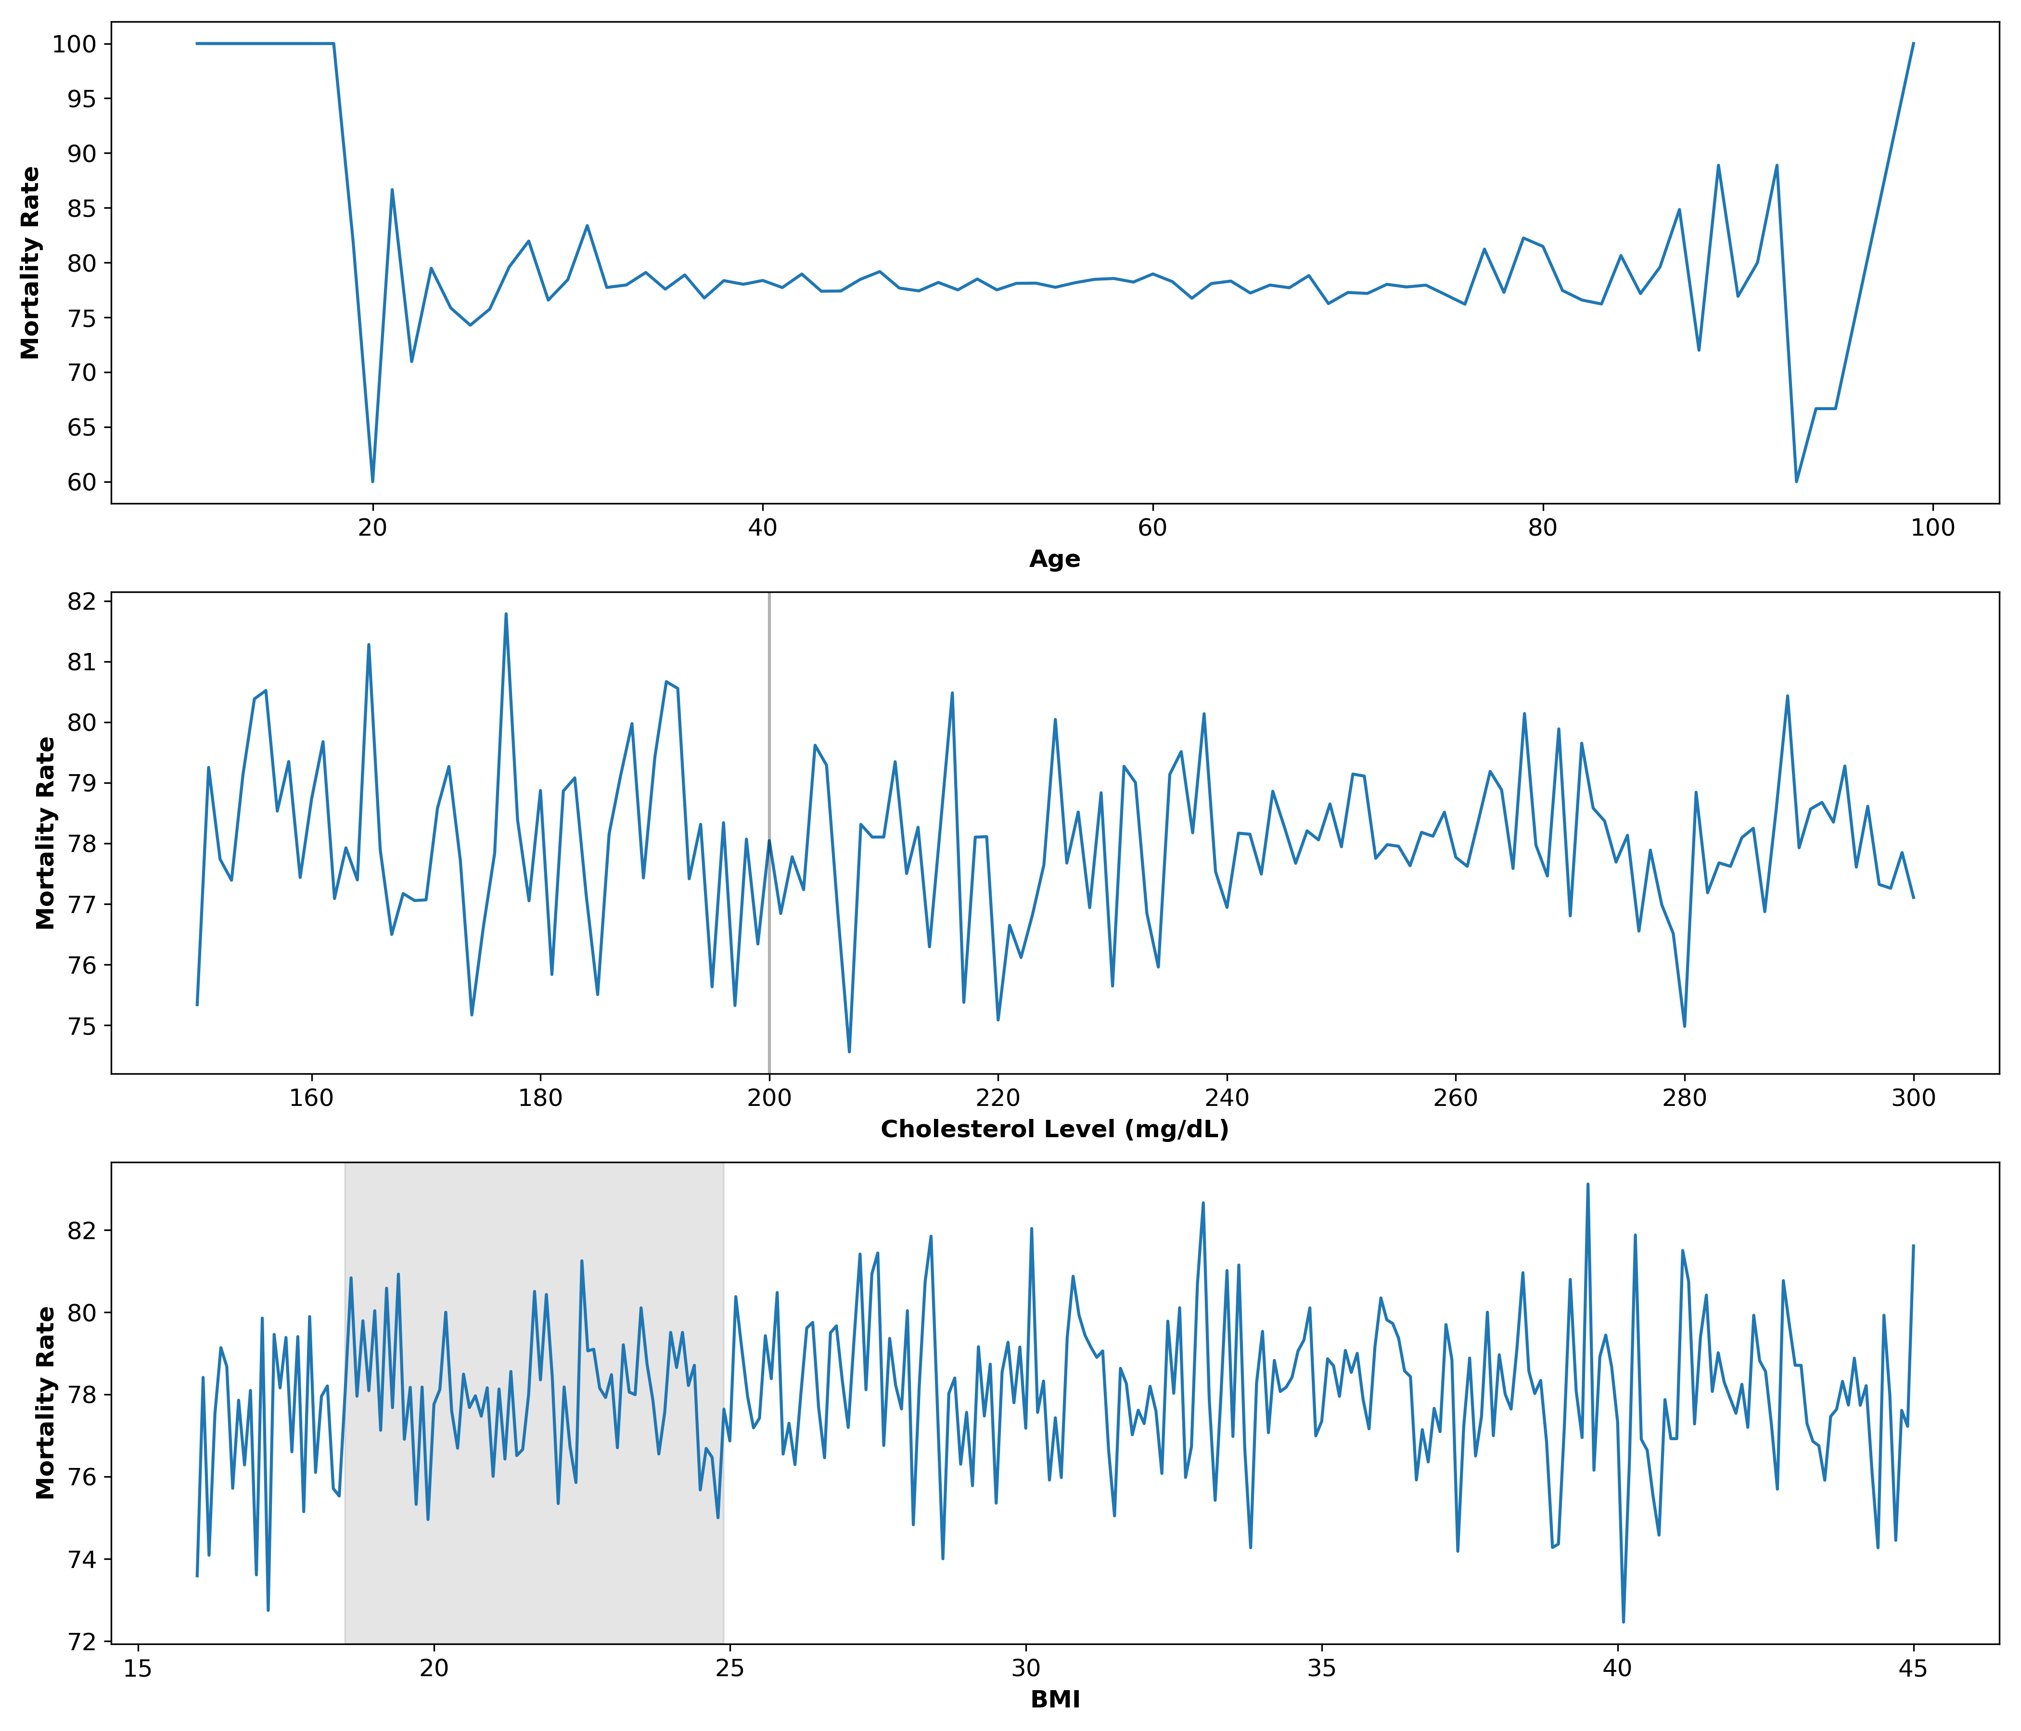
Continuous variables vs survival
Mortality rate fluctuates at young and older ages.
(Mann-Whitney U Test, U= 2269126354.5, p = 0.452
T test suggests while not significant the mean age of survival is higher than for patient that did not survive
Notes:
Talk about how

Slide 7
Continuous variables vs survival
Reported literature suggests that there is an increase in deaths where patient cholesterol is below 170
We can see high peaks of mortality and fluctuation below 200 mg/dl (threshold for high cholesterol)
While not significant our statistics suggests the mean is higher for patients who did not survive (Mann-Whitney U Test, U= 2259089271.5, p =0.596)

Slide 8
Continuous variables vs survival
Uniform fluctuations in BMI.
Mann-Whitney U Test suggests a higher BMI for patients that did not survive (Mann-Whitney U Test, U= 2269126354.5 , p = 0.452)
We can see this visualised with peaks in mortality at a BMI between 33 and 40

Slide 9
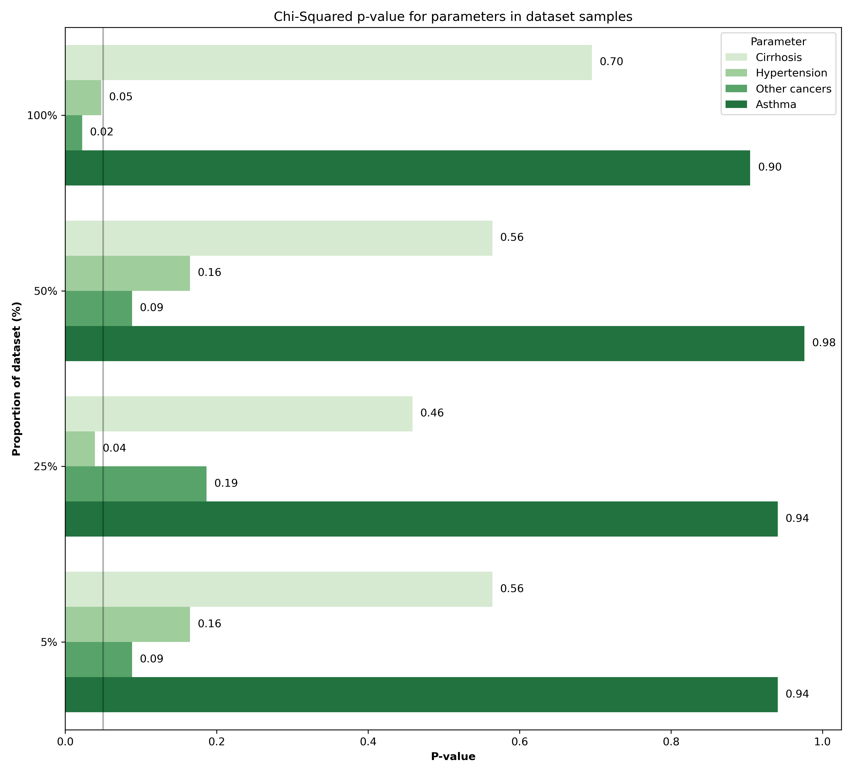
Sample size and statistical power trade off
0.05
Hypertension and presence of other cancers which have a statistically significant relationship with survival
Potentially these patterns were not picked up by the model because of the sample size we selected (because of computational limitations)

Slide 10
Sample size and statistical power trade off
OR = 1: No association
OR > 1: Positive association.
OR < 1: Negative association.
Parameters | Odds Ratio (OR) | P-value
Hypertension | 1.0061 | 0.0224
Other Cancers | 0.9886 | 0.0477
Even when a p value is significance it does not indicate the size of association
Running odds ratio suggests that even our parameters which are significant only have a small influence on survival
Having other cancers present slightly decreases risk of mortality
Having hypertension is a slight risk for lung cancer mortality

Slide 11
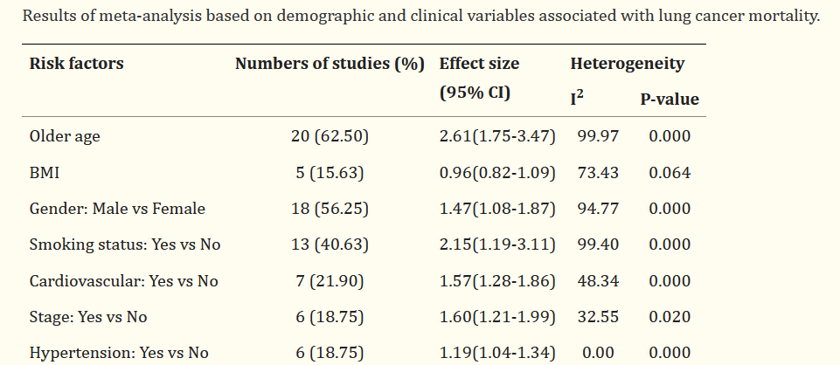
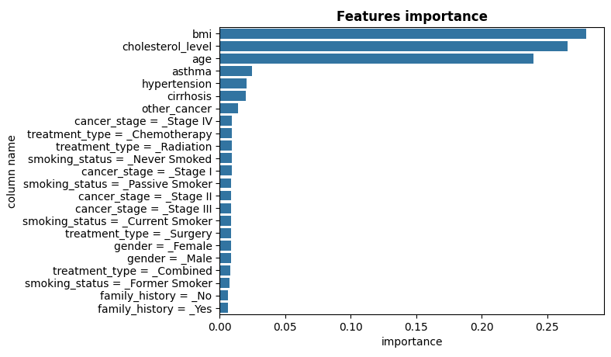
Published literature patterns and findings
Not a lot of agreement between studies
Our models did seem to pick up on features that are commonly reported on such as BMI and age
Publications on this topic show very high heterogeneity (contrasting conclusions)
This suggests they might not be reliable predictors and more research is needed

Slide 12
Conclusion
Predictors of mortality in lung cancer is a topical and highly debated topic
Much like any disease there are many factors that can influence outcome
As previously stated a larger dataset would help with feature selection and identifying strong predictors
There may be other unrecorded confounding effects which were not controlled for that influenced data distribution

Slide 13
References
https://www.ncbi.nlm.nih.gov/pmc/articles/PMC4296634/
https://www.ncbi.nlm.nih.gov/pmc/articles/PMC10754488/
https://www.sciencedirect.com/science/article/pii/S0085253815529748

